Slide 1
Time Series Sales Forecasting
Using Machine Learning and Deep Learning

Slide 2
Project Overview
Goal: Forecast future sales for a specific department using historical data and external factors.
Dataset: Weekly sales data for Department 24
Techniques Used:
Traditional Time Series Models (ARIMA, SARIMA, SARIMAX, Holt-Winters)
Machine Learning (Random Forest)
Deep Learning (LSTM, CNN)
Facebook Prophet
Deployment: Interactive Streamlit App

Slide 3
Data Preparation
Filtered Department: Dept 24
Datetime Index: Weekly frequency (W-FRI)
Handled: Missing values & frequency gaps
Created: Lagged features for recent sales
External Regressors:
Temperature
Fuel Price
CPI
Unemployment
IsHoliday

Slide 4
Exploratory Data Analysis (EDA)

Slide 5
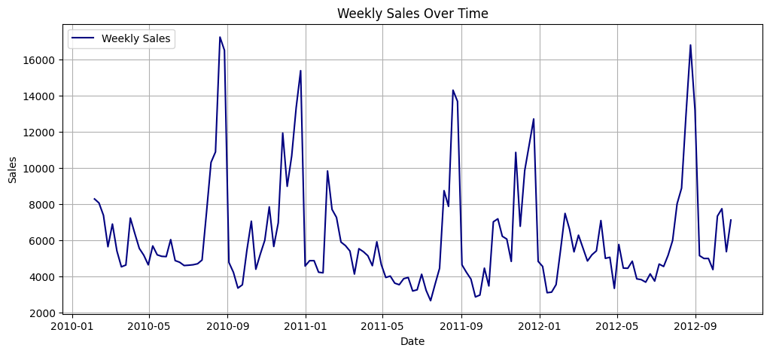
Visuals
Time plot of sales
Seasonal decomposition
ACF & PACF plots to inspect lags

Slide 6
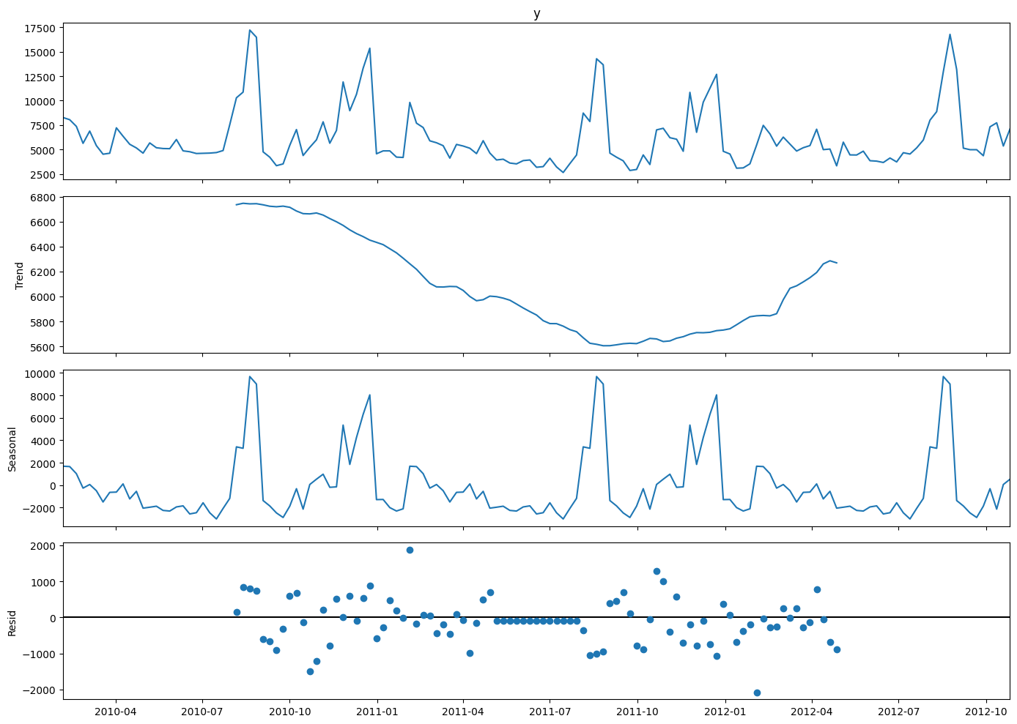
Visuals
Time plot of sales
Seasonal decomposition
ACF & PACF plots to inspect lags

Slide 7
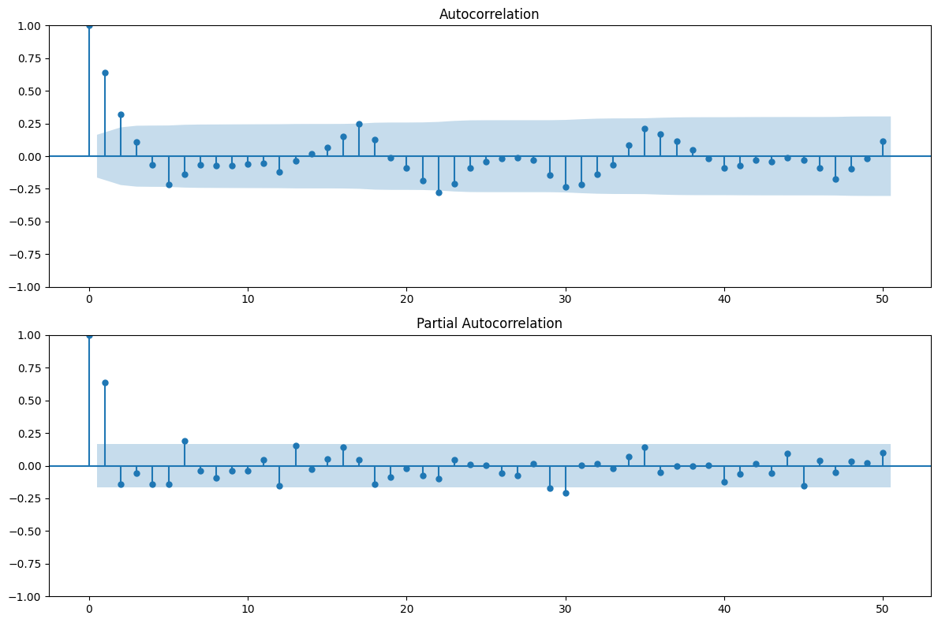
Visuals
Time plot of sales
Seasonal decomposition
ACF & PACF plots to inspect lags

Slide 8
Stationarity Test
ADF test → Series is stationary
As p-value < 0.05 and
ADF stat < critical values → Stationary

Slide 9
Models Evaluation

Slide 10
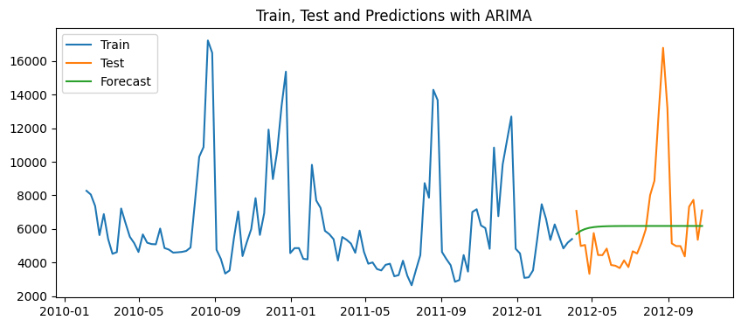
ARIMA
MAE = 2190.073757
RMSE = 3071.117969

Slide 11
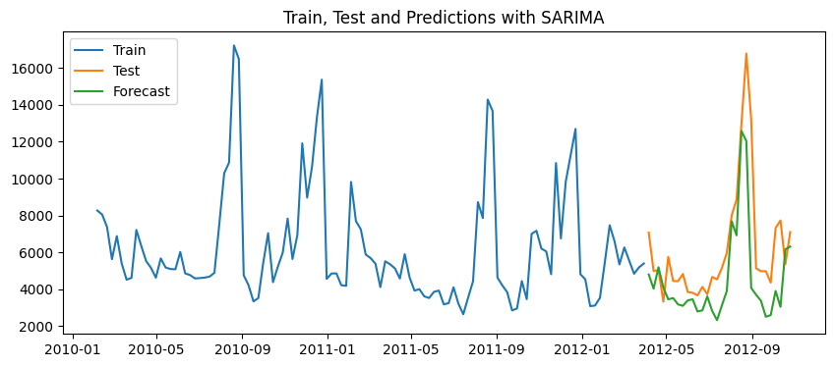
SARIMA
MAE = 1834.447751
RMSE = 2549.707551

Slide 12
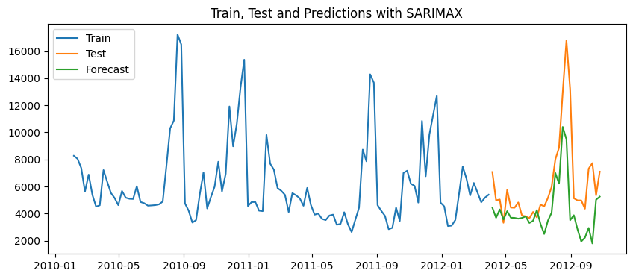
SARIMAX
MAE = 2070.090028
RMSE = 2980.891804

Slide 13
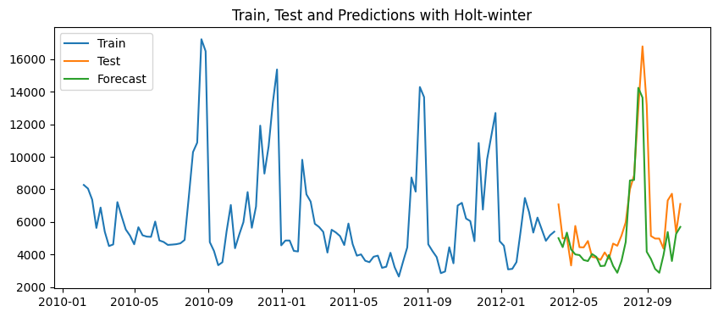
Holt-winter
MAE = 1439.964416
RMSE = 2209.412522

Slide 14
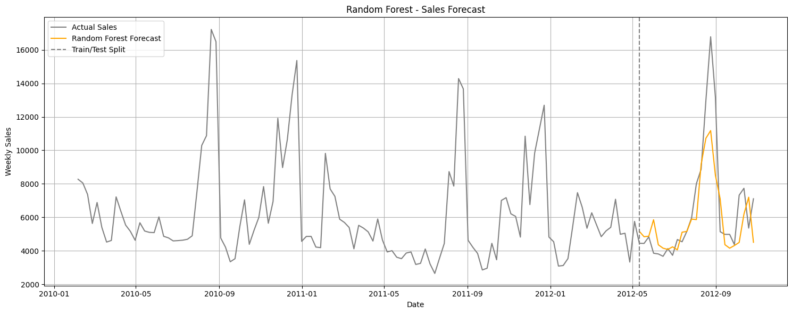
Random Forest
MAE = 1330.020244
RMSE = 1945.401270

Slide 15
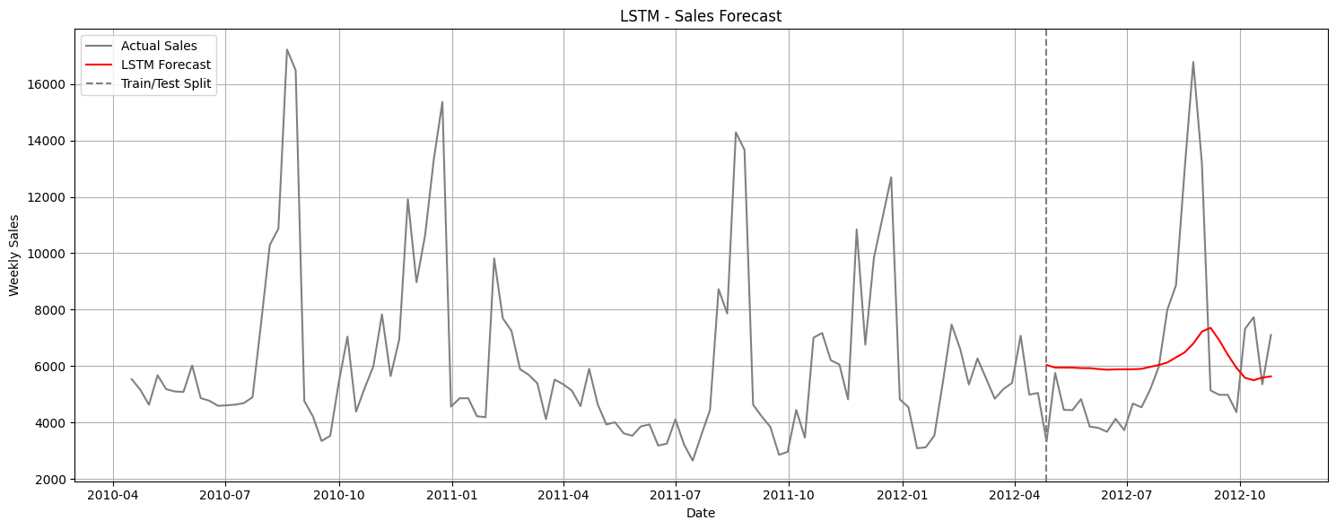
LSTM
MAE = 6108.700960
RMSE = 6126.379139

Slide 16
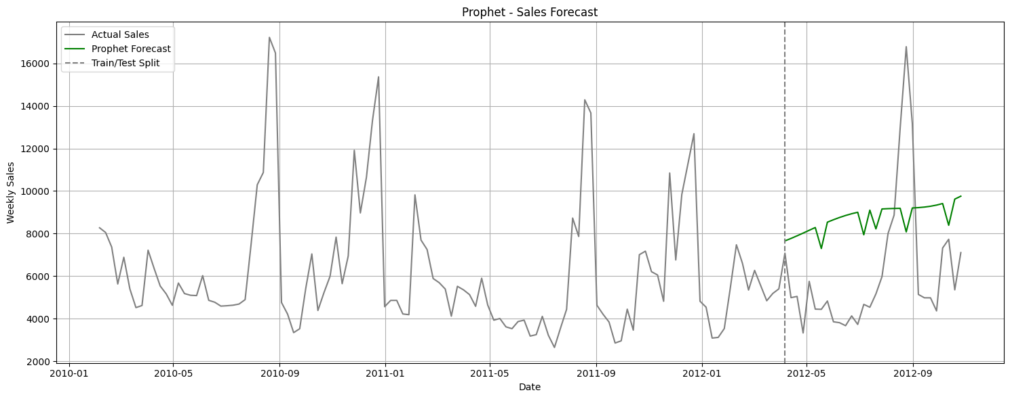
Prophet
MAE = 3600.548152
RMSE = 3968.072327

Slide 17
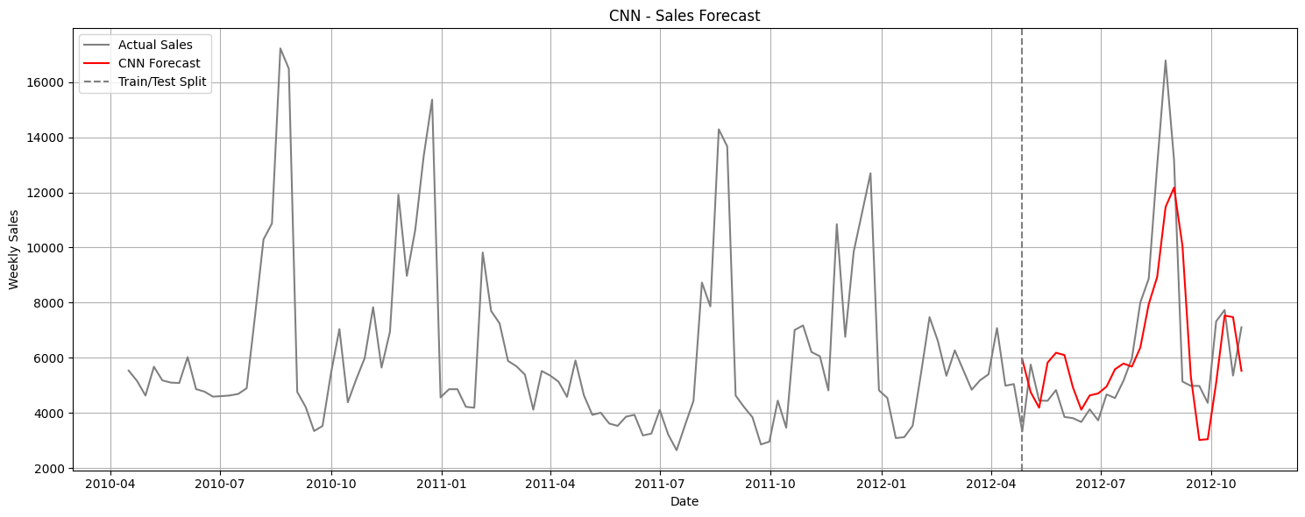
CNN
MAE = 1545.883625
RMSE = 2036.921347

Slide 18
Final Comparison
Model | MAE | RMSE
Random Forest | 1330.020244 | 1945.401270
CNN | 1545.883625 | 2036.921347
Holt-Winters | 1439.964416 | 2209.412522
SARIMA | 1834.447751 | 2549.707551
SARIMAX | 2070.090028 | 2980.891804
ARIMA | 2190.073757 | 3071.117969
Prophet | 3600.548152 | 3968.072327
LSTM | 6108.700960 | 6126.379139
Final Best Model Selected: Random Forest

Slide 19
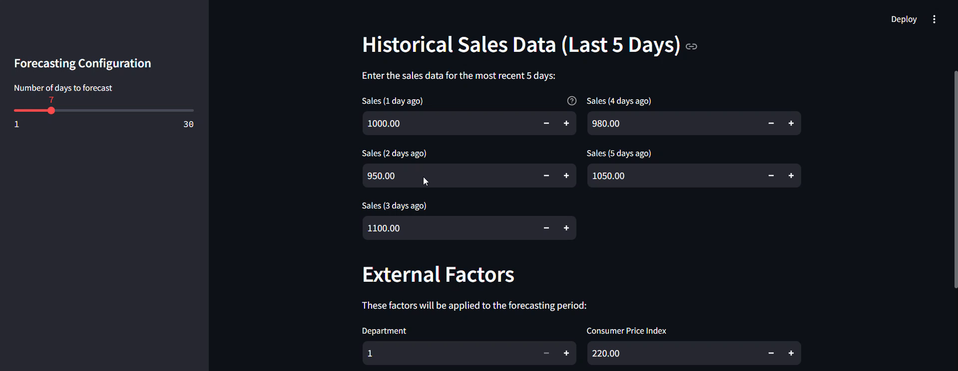
Streamlit App Deployment
Functionality:
User inputs: recent sales, holiday config, external factors
Forecasts next 1–30 days
Visualizes results and allows CSV export
Tech Used:
Model: Random Forest (sales_forecasting_modell.pkl)
UI: Streamlit
Plotting: Plotly
https://time-series-project-2jf6ryc3zgnuxopwzrgv5p.streamlit.app/

Slide 20

Thank you

